Slide 1
More on K Nearest Neighbour algorithm

Slide 2
What Is KNN Algorithm?
Does KNN belong to a Supervised Machine Learning? YES!
What is the goal of the algorithm? It classifies a new data point into the target class
What is the main criteria of classification? The features of a new data neighboring data points.

Slide 3
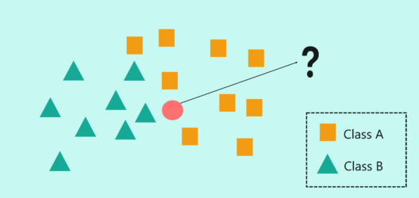
I
In the above image, we have two classes of data, namely class A (squares) and Class B (triangles)
The problem statement is to assign the new input data point to one of the two classes by using the KNN algorithm
The first step in the KNN algorithm is to define the value of ‘K’. But what does the ‘K’ in the KNN algorithm stand for?
‘K’ stands for the number of Nearest Neighbors and hence the name K Nearest Neighbors (KNN).

Slide 4
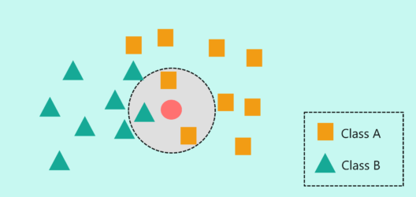
In the above image, I’ve defined the value of ‘K’ as 3. This means that the algorithm will consider the three neighbors that are the closest to the new data point in order to decide the class of this new data point.
The closeness between the data points is calculated by using measures such as Euclidean and Manhattan distance
At ‘K’ = 3, the neighbors include two squares and 1 triangle. So, if I were to classify the new data point based on ‘K’ = 3, then it would be assigned to Class A (squares).

Slide 5
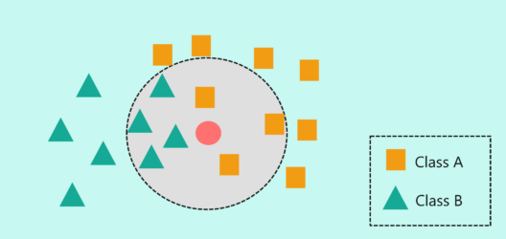
But what if the ‘K’ value is set to 7? We are telling our algorithm to look for the seven nearest neighbors and classify the new data point into the class it is most similar to.
At ‘K’ = 7, the neighbors include three squares and four triangles. So, if I were to classify the new data point based on ‘K’ = 7, then it would be assigned to Class B (triangles) since the majority of its neighbors were of class B.

Slide 6
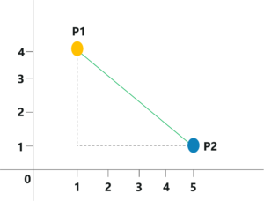
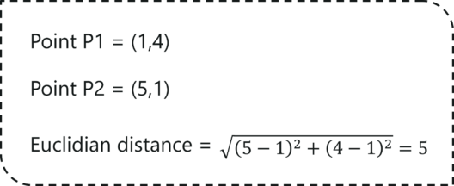

Slide 7
1. Determine parameter K = number of nearest neighbors
2. Calculate the distance between the query-instance and all the training samples
3. Sort the distance and determine nearest neighbors based on the K-th minimum
distance
4. Gather the category Y of the nearest neighbors
5. Use simple majority of the category of nearest neighbors as the prediction value of the query instance

Slide 8
TISSUE CLASSIFICATION EXAMPLE
https://people.revoledu.com/kardi/tutorial/KNN/KNN_Numerical-example.html

Slide 9
THE NEXT SOURCE:
Compare C++ and Python Codes
https://www.geeksforgeeks.org/k-nearest-neighbours/

